Slide 1
Project 3 Report P4
Group 4
Saman, Shihao, Venkata, Sudhanshu

Slide 2
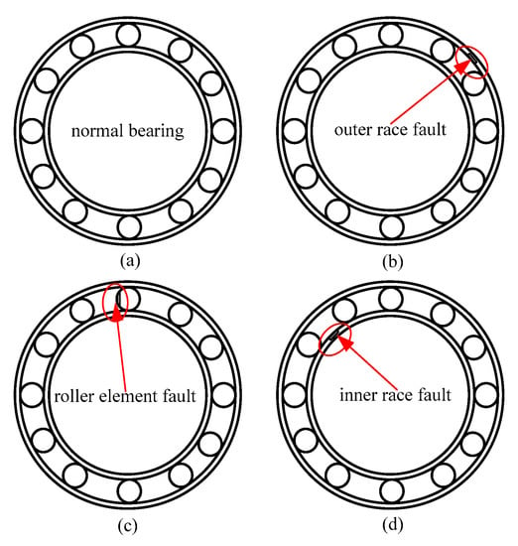
Review
Bearing health condition classification
Training data & Test data with labels
7 different unbalanced conditions
&
1 normal condition
Goal is training a model to identify which condition it is from the test data

Slide 3
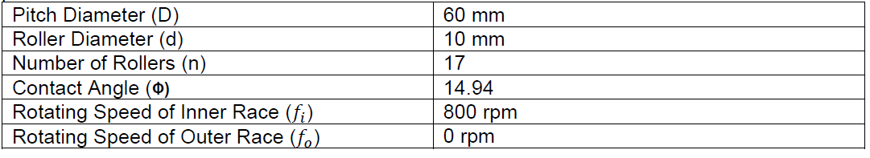
Bearing Specifications
The dimension and parameters needed for calculating fault frequencies

Slide 4
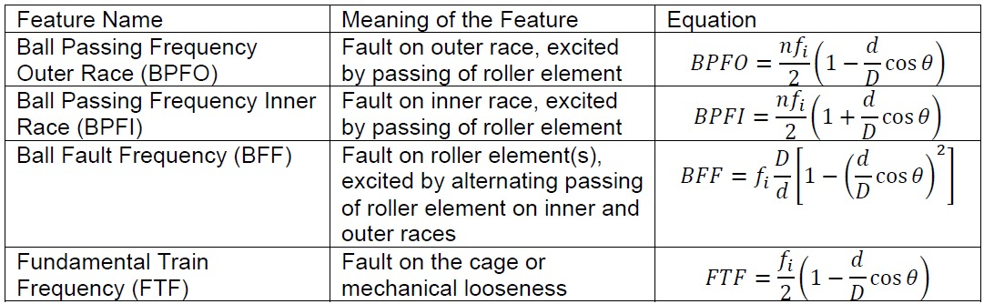
Frequencies related with bearing faults

Slide 5
Previously
4 models
  SVM ---- 100% accuracy
  RF, KNN ---- 99.8% → 100% accuracy
  SOM ---- 97.85% → 98.63% accuracy → 99.41% accuracy

Slide 6
Last week
Optimize the SOM model
Conduct 5-fold cross validation

Slide 7
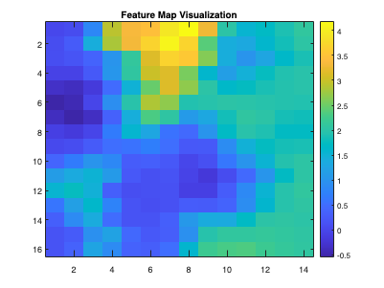
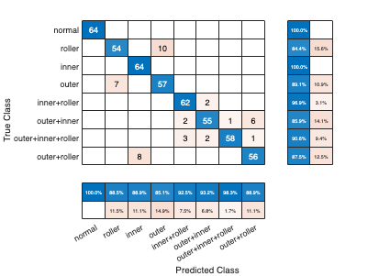
SOM Optimization - New features
Skewness + STD +RMS + Peak frequency
Accuracy: 91.7969%
7.7%

Slide 8
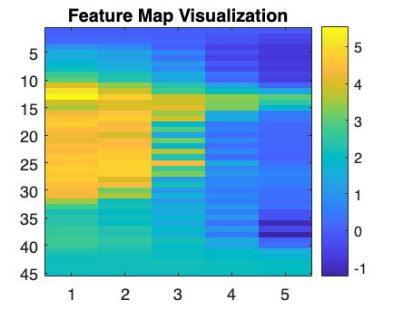
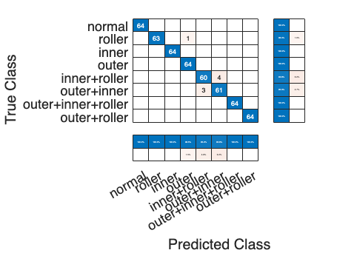
SOM Optimization - New features
Skewness + STD +RMS + 2x harmonic
Accuracy: 98.4375%
1%

Slide 9
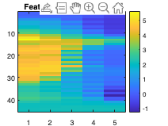
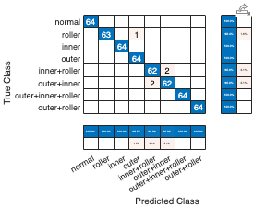
SOM Optimization - New features
Skewness + STD +RMS + 1x harmonic
Accuracy: 99.0234%
0.4%

Slide 10
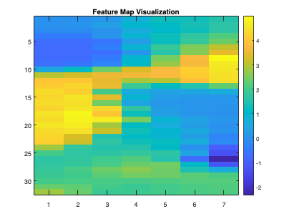
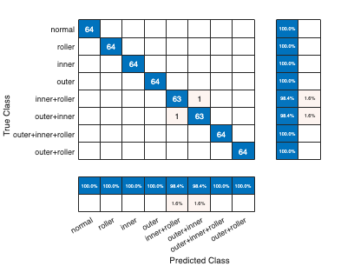
SOM Optimization - New features
Skewness + STD + MAV
Accuracy: 99.6094%
0.2%

Slide 11
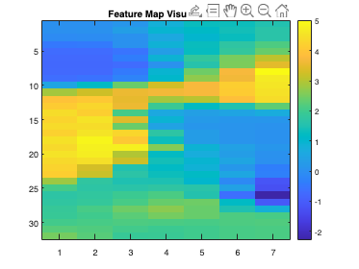
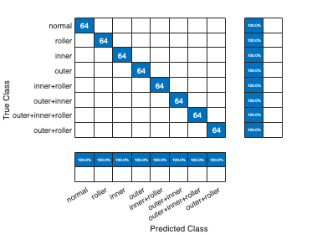
SOM Optimization - New features
Skewness + STD + MAV + 1x harmonic
Accuracy: 100%
0.6%

Slide 12
Feature Selection Standard
Features analysis
PCA
Feature importance score

Slide 13
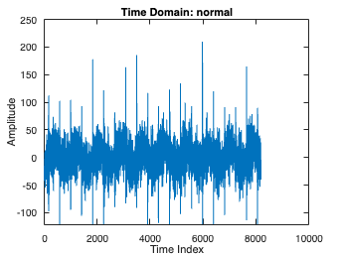
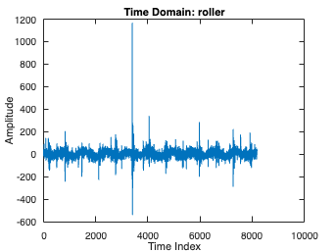
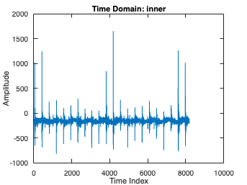
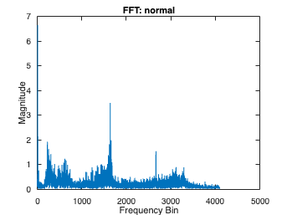
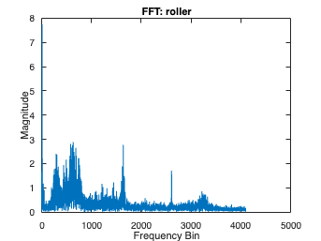
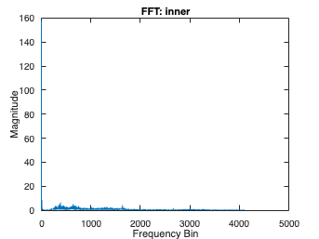
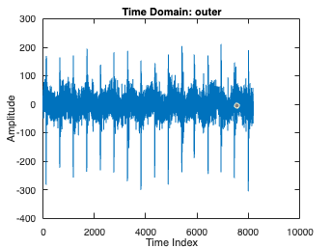
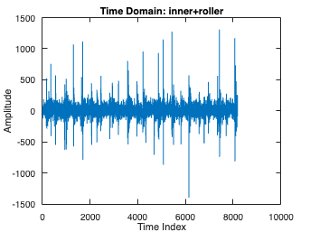
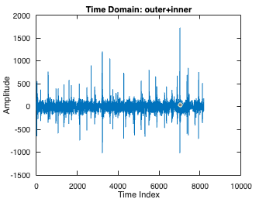
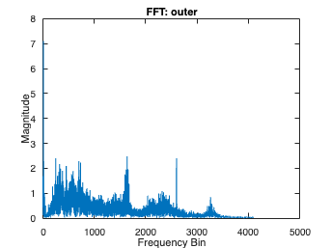
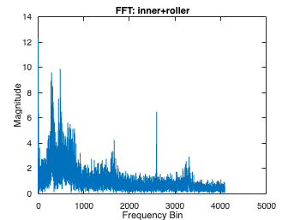
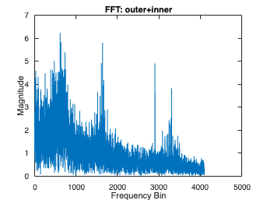
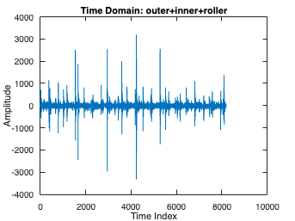
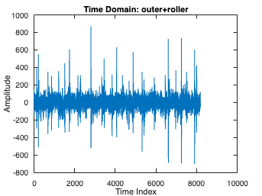
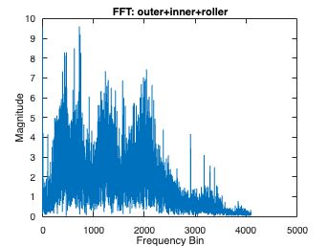
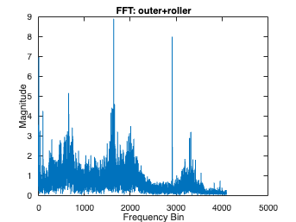
Feature Selection Standard - Features Analysis
Time domain
Frequency domain

Slide 14
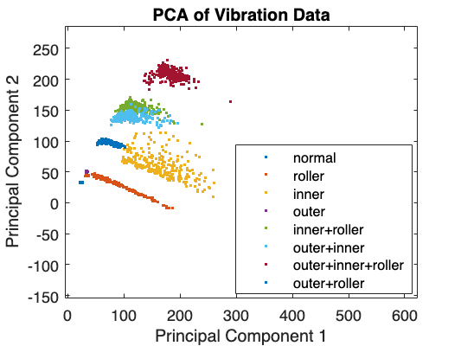
Feature Selection Standard - PCA

Slide 15
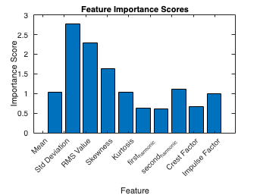
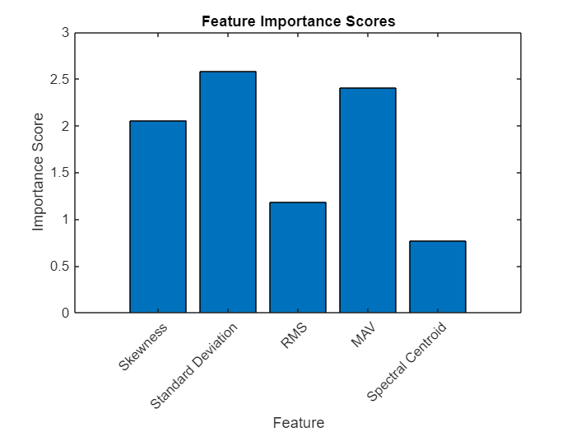

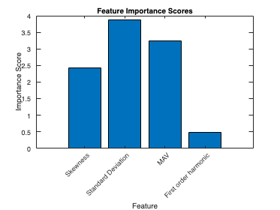
Feature Selection Standard - Feature importance score
97.8516% accuracy
99.4141% accuracy
100% accuracy

Slide 16
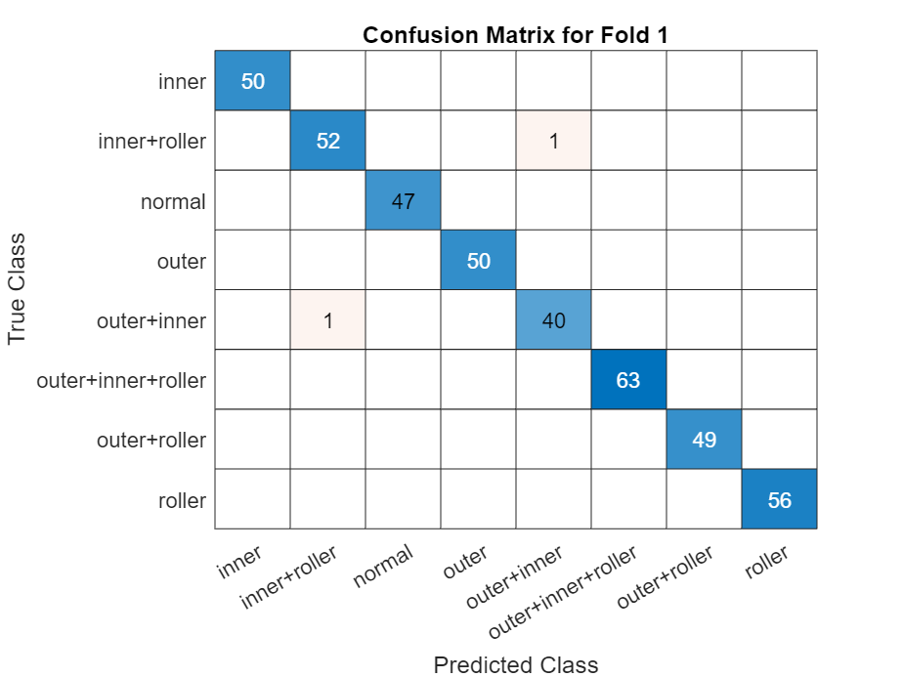
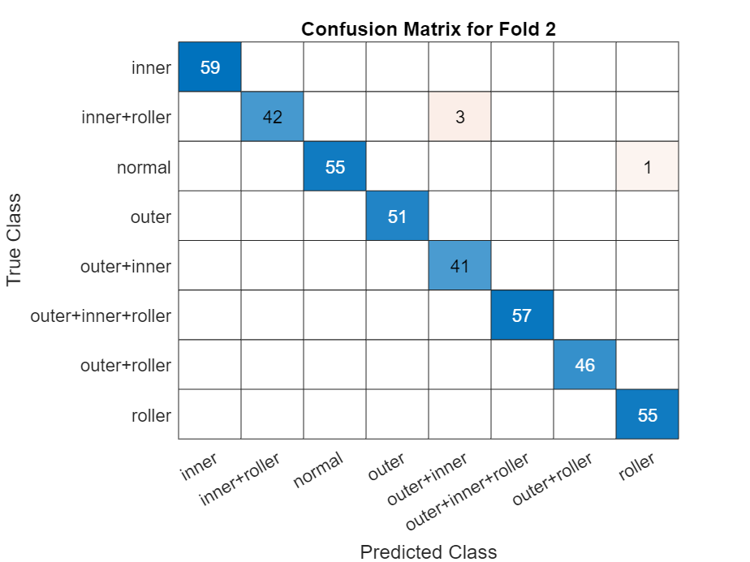
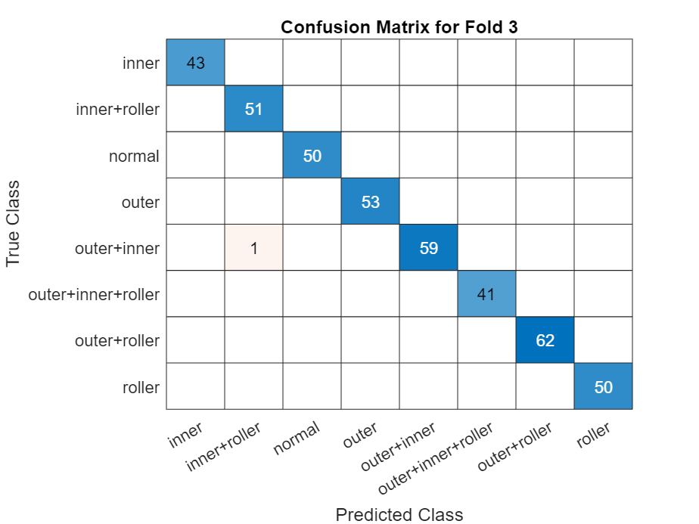

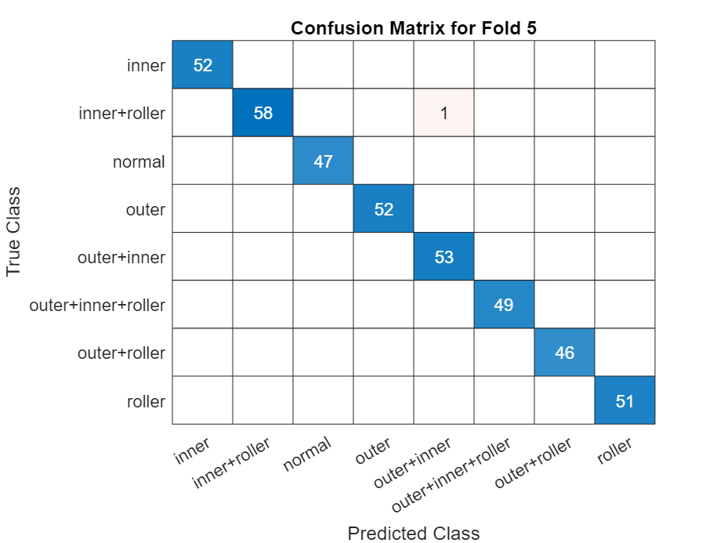
Cross validation - KNN
Average Accuracy: 99.5118%

Slide 17
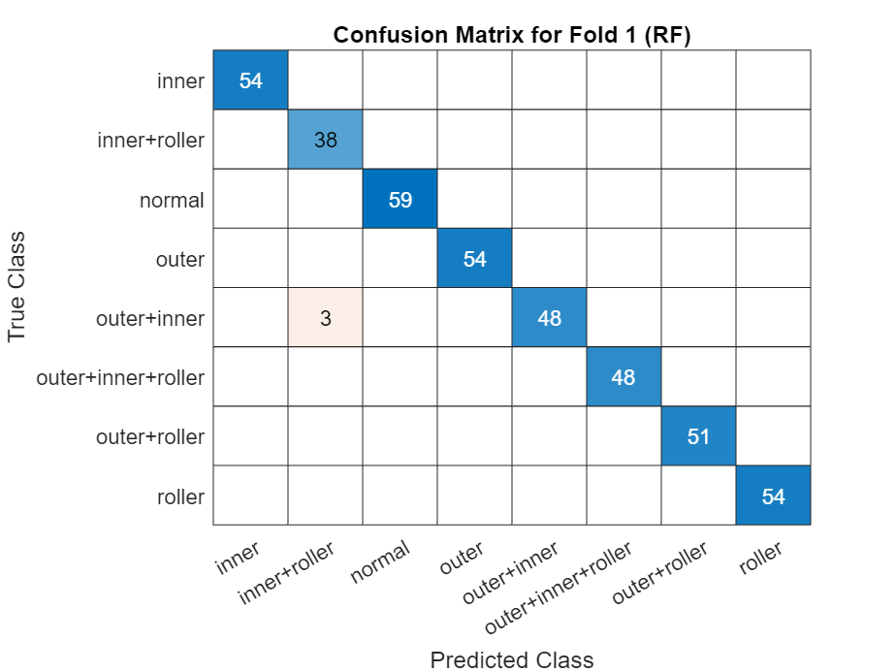




Cross validation - RF
Average Accuracy: 99.6093%

Slide 18





Cross validation - SVM
Average Accuracy: 99.6582%

